Slide 1
Home Automation with NodeMCU
Presented to:
Abdullah Al Farhad
Lecturer Dept. of CSE
Green University of Bangladesh
Presented by:
Jannatul Mawa Sriti
ID: 232002070
Md. Sohan Millat Sakib
ID: 222902036
Abul Sadik Bappy
ID: 232002265

Slide 2
1
Content
Introduction
Part of the project
Login System
Control System
NodeMCU Control System
Working Procedure
Project developing
Advantage
Limitation

Slide 3
2
Introduction
Home automation with NodeMCU enables users to remotely control and monitor home appliances using Wi-Fi connectivity. This system enhances convenience, energy efficiency, and ease of use through smart technology integration.

Slide 4
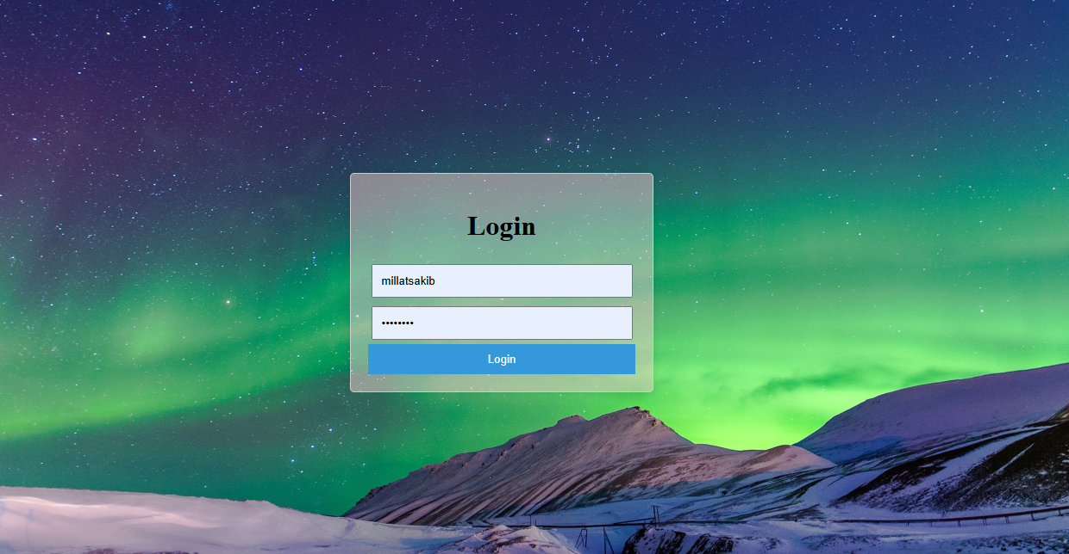

3
Part of the Project
Login System
Control System
Micro controller NodeMCU control System.
Login
Dashboard

Slide 5

4
Login System
Login system is the procedure used to get access to the control system of application.

Slide 6
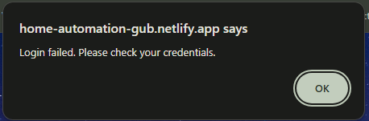
5
Login System
Handled Unauthorize User.
Redirect Authorised User.
Unauthorized Login
Redirted DashBoard

Slide 7
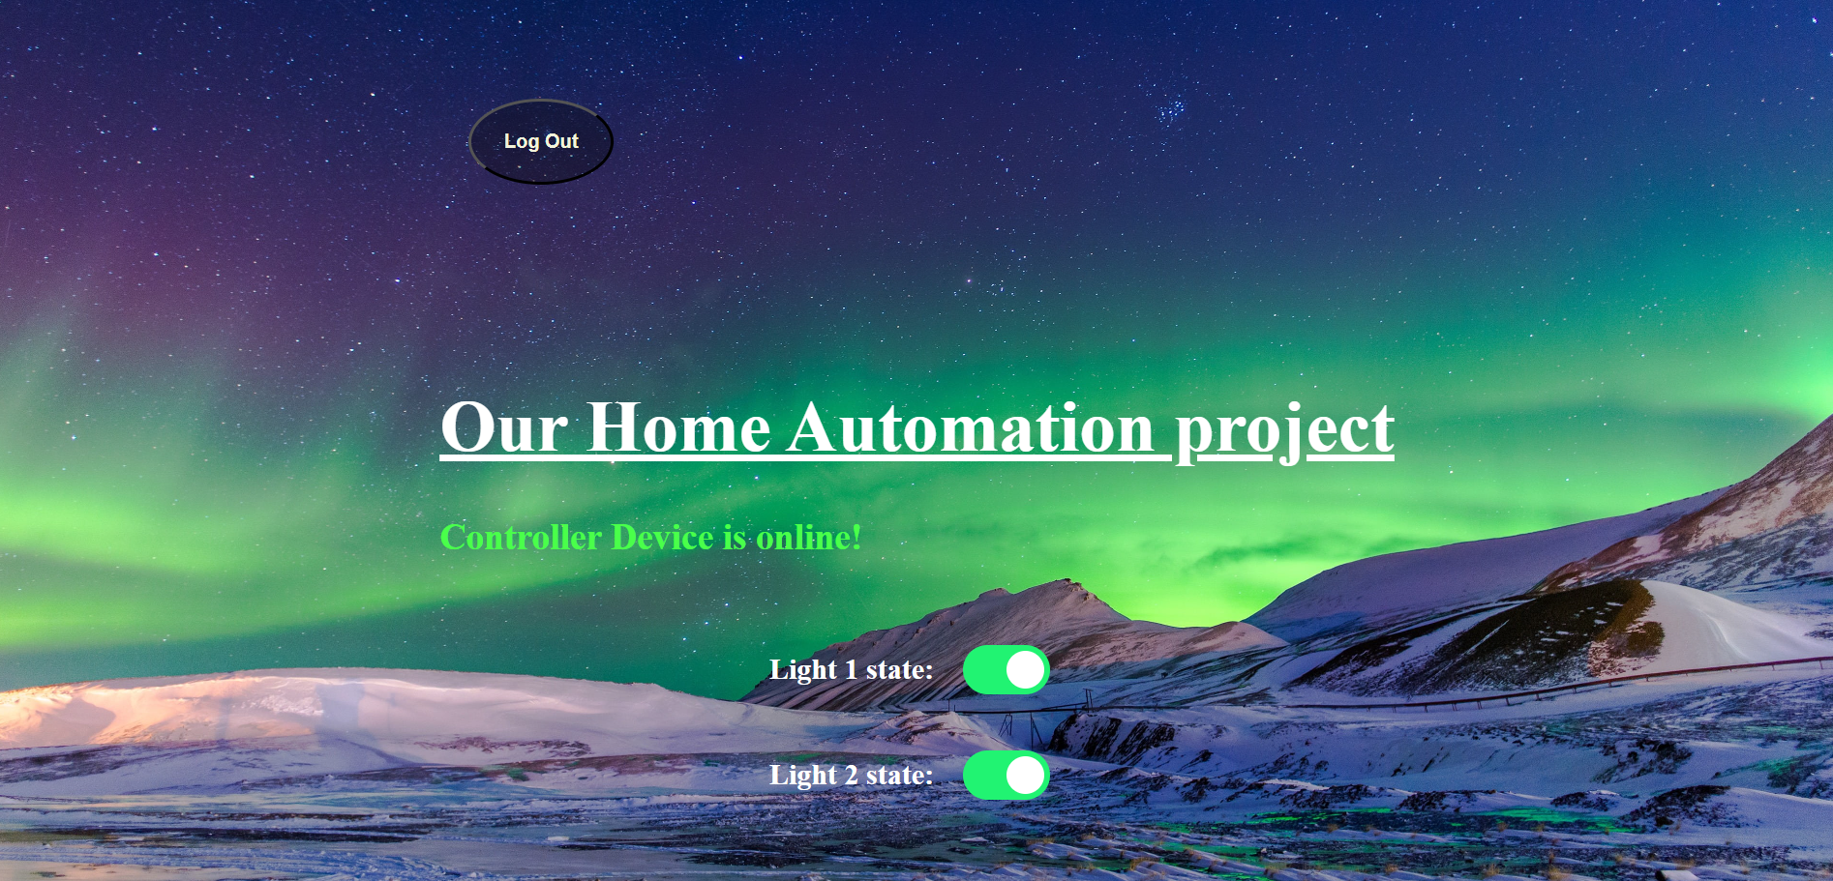
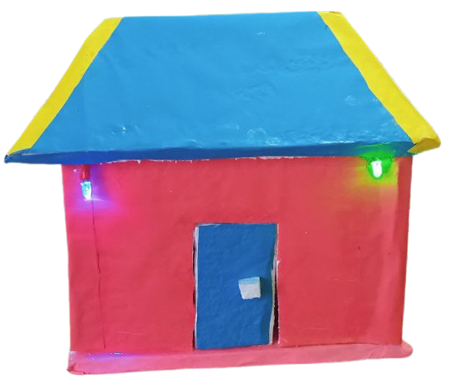
7
Control System
User Can See the device is connected with internet or not.
User can toggle the switch
User can logout from the system if he want.
User Dashboard
Home Loads

Slide 8
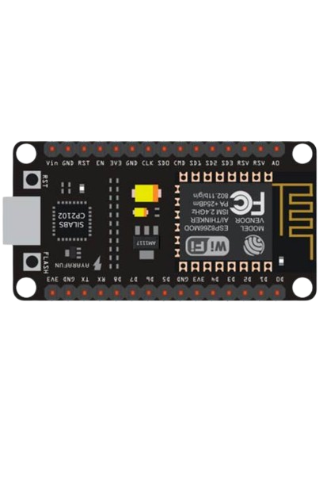
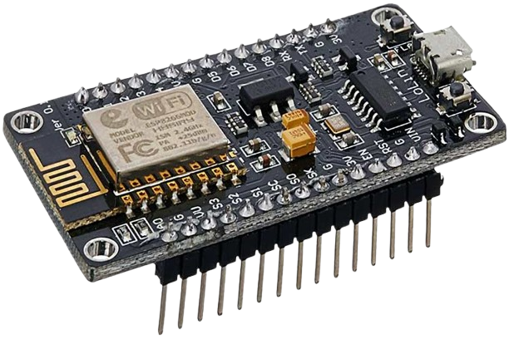
11
NodeMCU Control System
Main Part of Project
Control device depending on Server Data
Save the Last stage on EEPRom.
NodeMCU

Slide 9

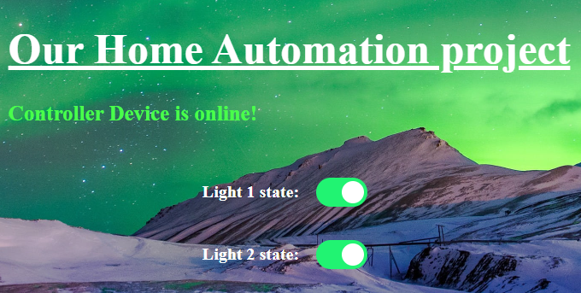

Working Procedure
How Data Passing with each other?

Slide 10
12
Project Developing
NodeMCU
C Language
Arduino IDE
Blynk
API
Html
CSS
JavaScript

Slide 11
13
Advantage
It has many advantage :
Convenience and Remote Control
Energy Efficiency
Cost-Effective Solution

Slide 12
14
Limitation
It has some Limitation :
5GHz Compatibility Issues
Security Concerns
Can control 8 device only.

Slide 13
Thank You

